Slide 1
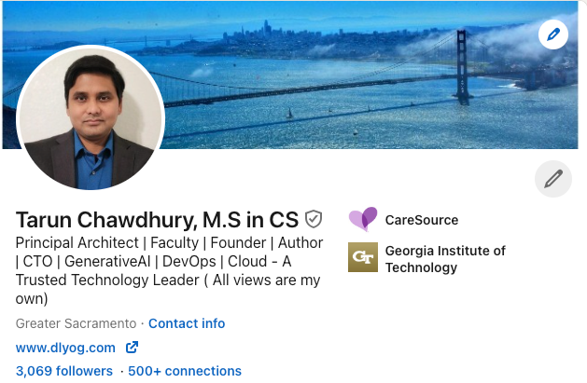
https://www.linkedin.com/in/tarunchawdhury/

Slide 2
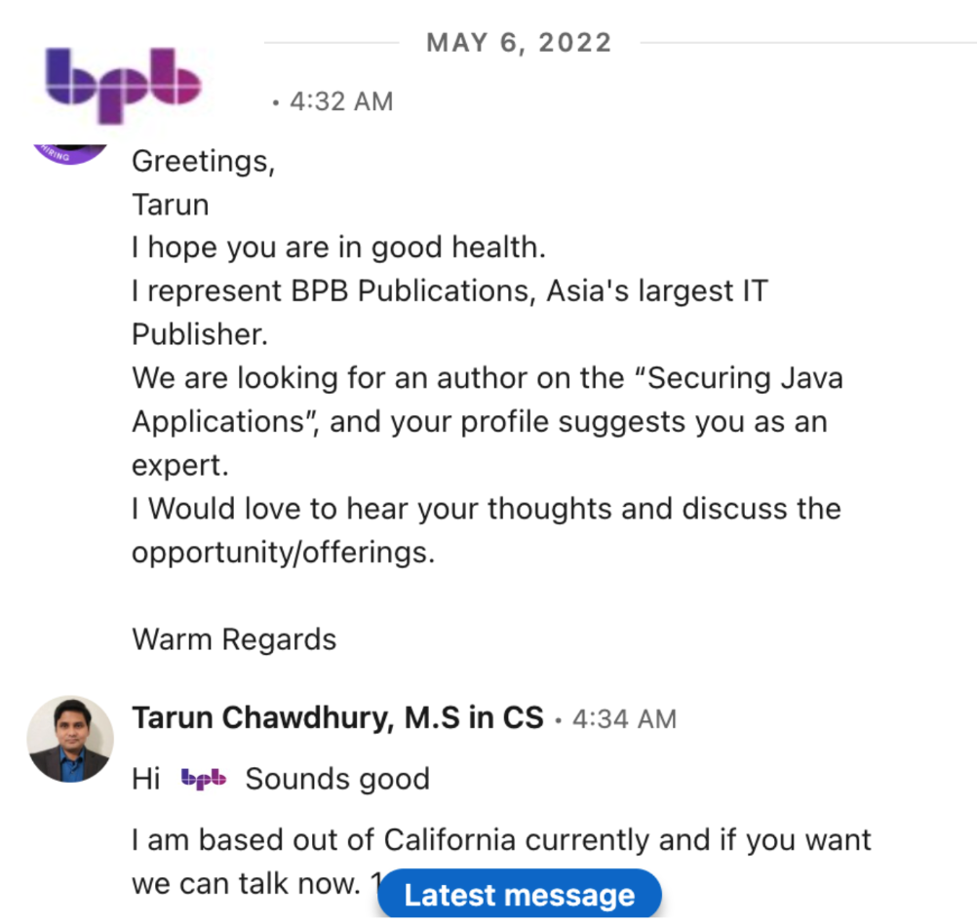


Slide 3
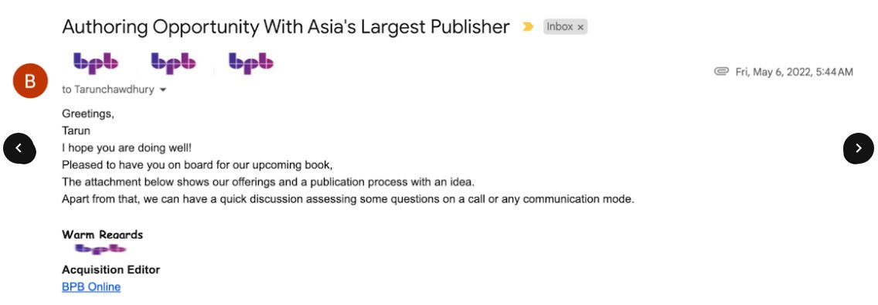

Slide 4
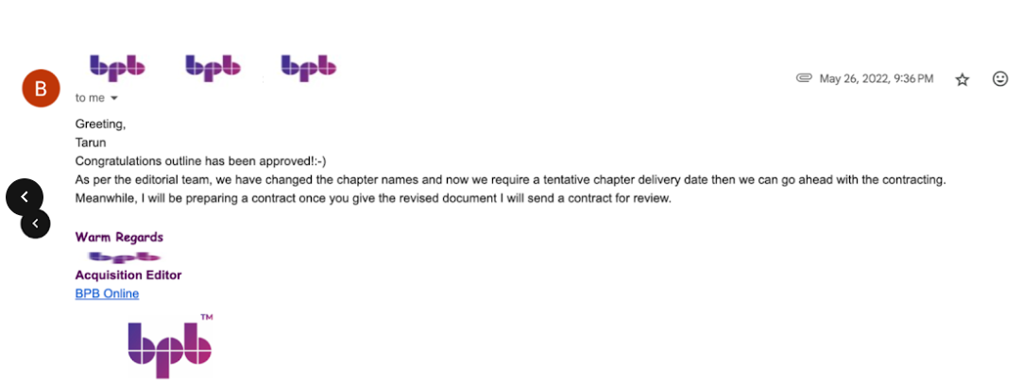

Slide 5


Slide 6


Slide 7


Slide 8


Slide 9


Slide 10


Slide 11


Slide 12
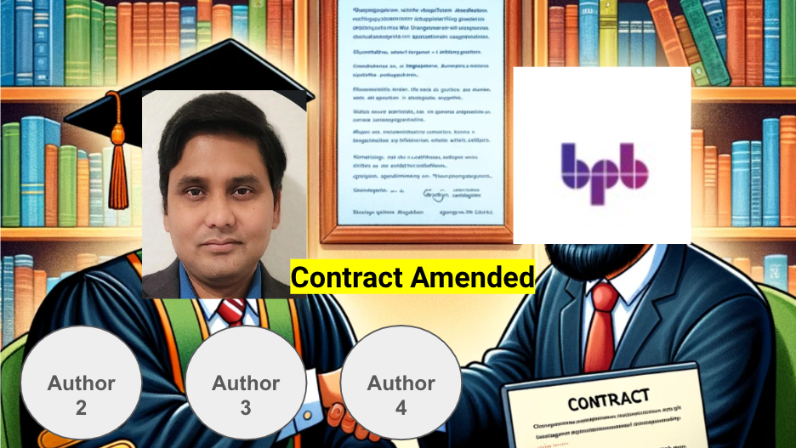
Debopam
Joyanta
Vipul

Slide 13


Slide 14
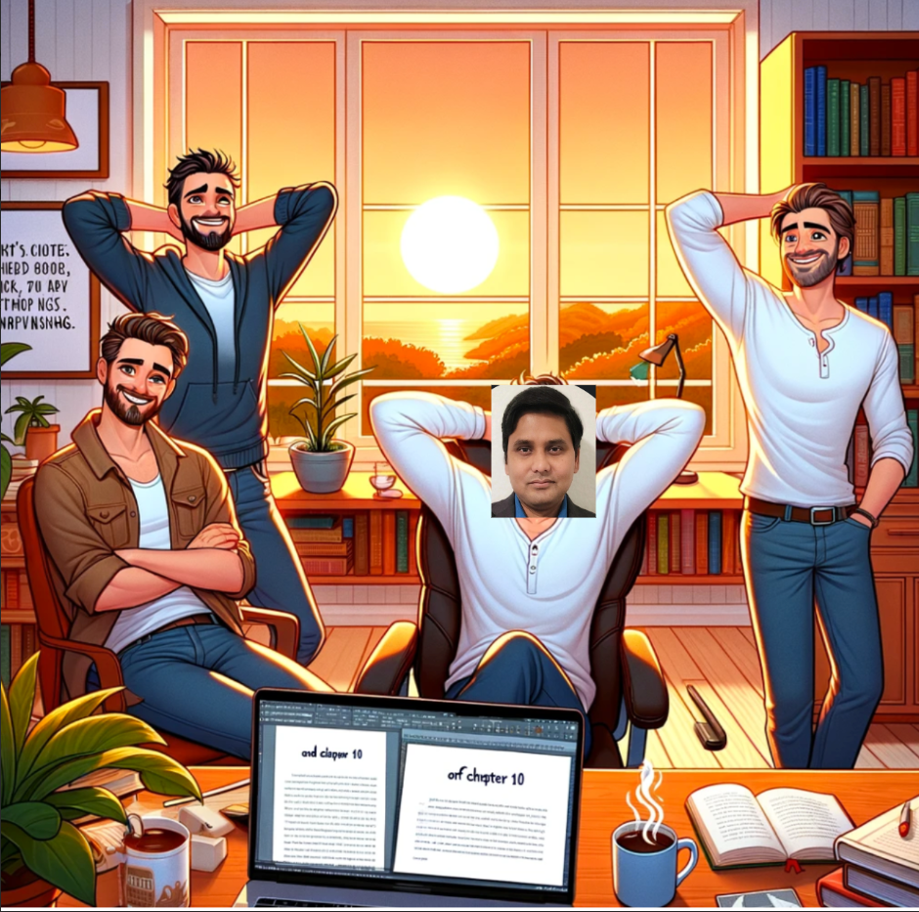

Slide 15


